Slide 1
Comparison between Semantic Segmentation techniques
Presentation by: Vinita Boolchandani
Course: B659, Vision for Intelligent Robotics (Fall 2017)
Professor: Michael Ryoo

Slide 2
Motivation for Semantic Segmentation
Autonomous Driving
Help visually impaired people
Robotics: Robots need it to understand different objects.

Slide 3
FCN vs CRF-RNN
Basic idea of FCN
Basics of CRF-RNN
Some image outputs produced by the two

Slide 4
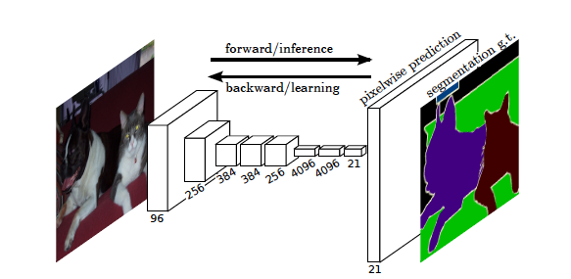
Semantic Segmentation using Fully Convolutional Network
Learnable Upsampling Map
Learn the Upsampling as a part of network

Slide 5
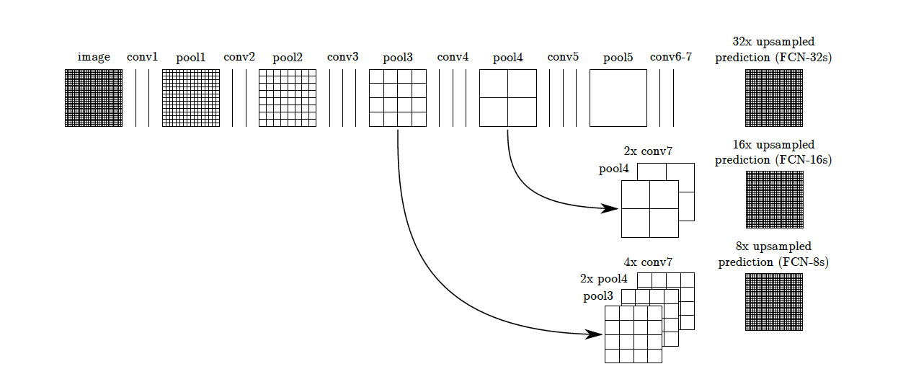
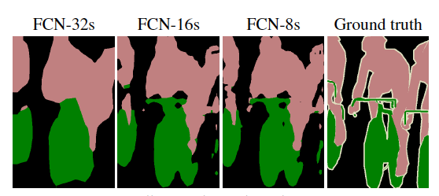
Semantic Segmentation: Upsampling
Bigger feature maps
Skip Connections

Slide 6
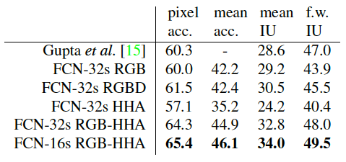
Training and Results
The loss was calculated as the sum of individual pixel loss.
PASCAL VOC:

Slide 7
What are CRFs?
Probabilistic framework used for labelling.
Underlying idea: Instead of joint distribution it uses conditional probability distribution over label sequence and observed sequence.
Models pixel labels as random variables that form a Markov Random Field (MRF) when conditioned upon a global observation(Image)
Outperformed: convolutional filters with large receptive fields and hence coarse outputs (FCN)

Slide 8
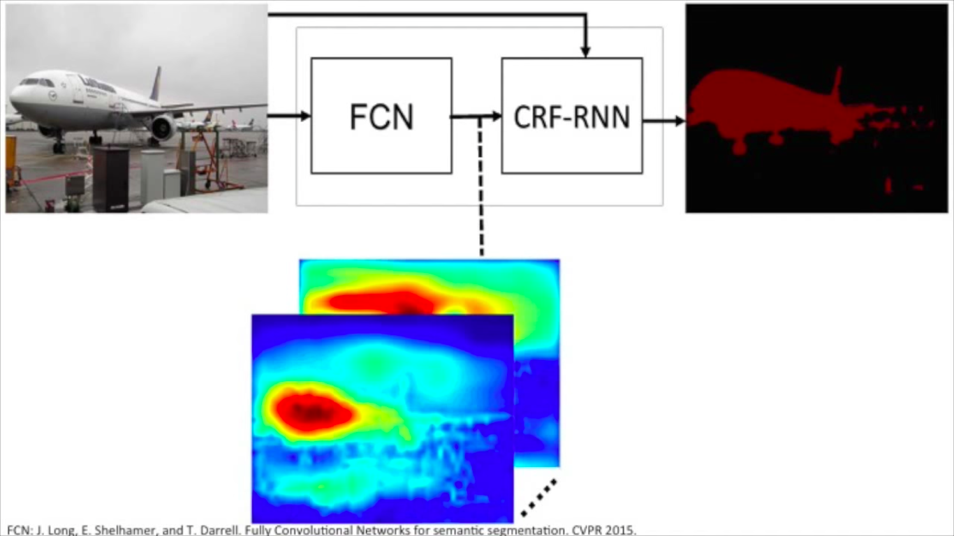
Conditional Random Fields as RNN
CRF integrated with deep network
Combined strength of CNN and CRF

Slide 9
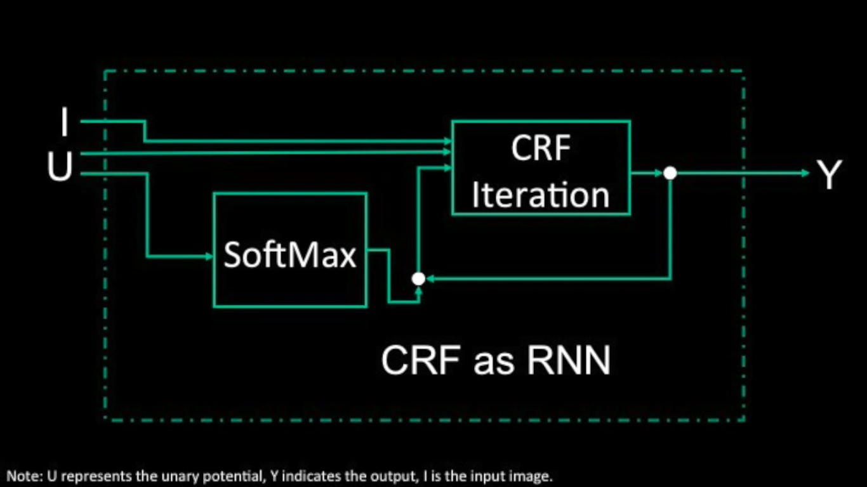

Slide 10
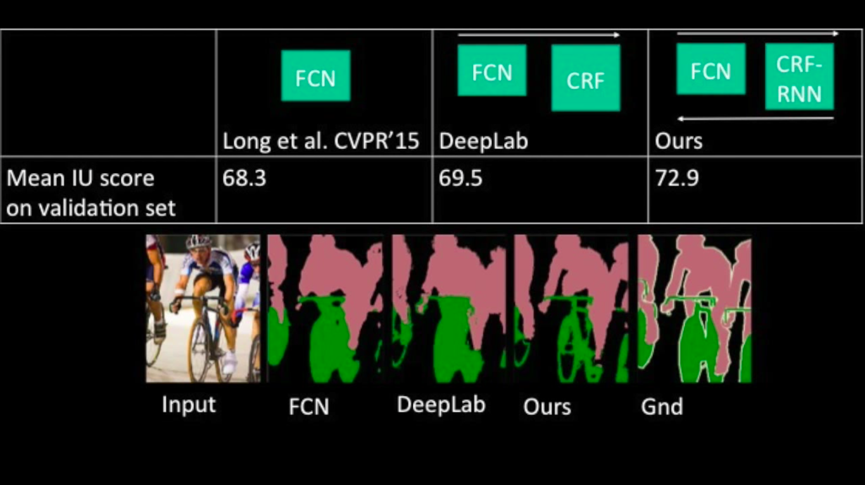
Performance

Slide 11
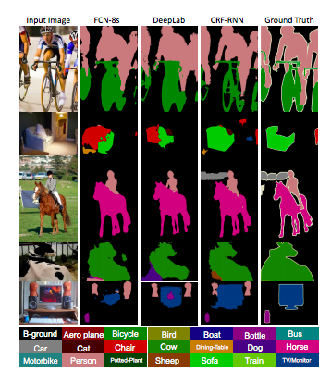
PASCAL VOC Result Comparison

Slide 12
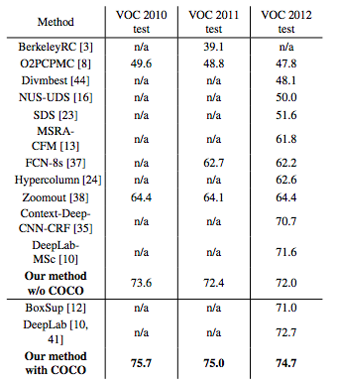
Performance

Slide 13
Summarizing
Fully Convoluted Network
Uses just an FCN with skip architecture
Trained on PASCAL VOC
CRF as RNN
Uses CRF-RNN over FCN
Trained on PASCAL VOC and MS Coco

Slide 14
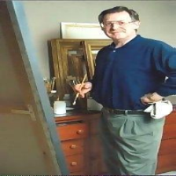
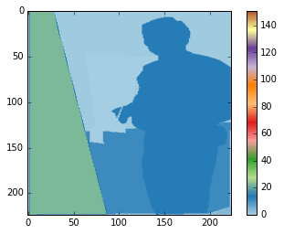
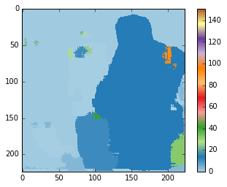
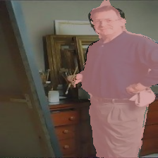
Comparison Results-MIT Scene Parsing
Input
Ground Truth
FCN
CRF-RNN

Slide 15
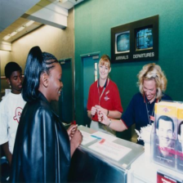
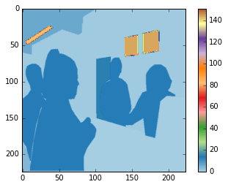
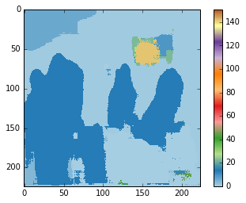
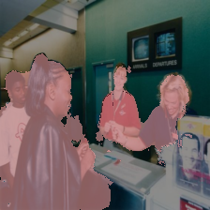
Comparison Results-MIT Scene Parsing
Input
Ground Truth
FCN
CRF-RNN

Slide 16
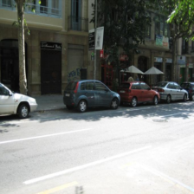
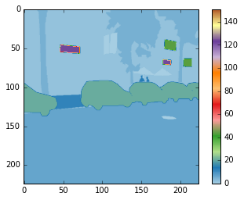
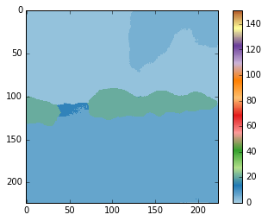
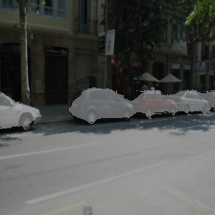
Comparison Results-MIT Scene Parsing
Input
Ground Truth
FCN
CRF-RNN

Slide 17
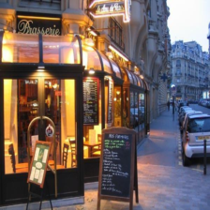
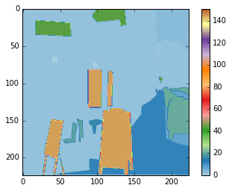
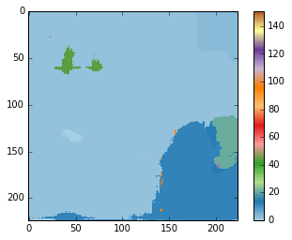
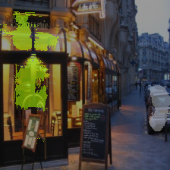
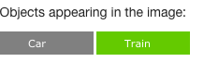
Failure-MIT Scene Parsing
Ground Truth
FCN
CRF-RNN

Slide 18


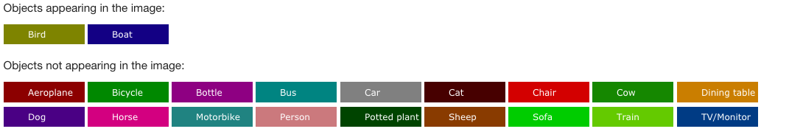
CRF as RNN tested on Random Images
Input
CRF-RNN

Slide 19
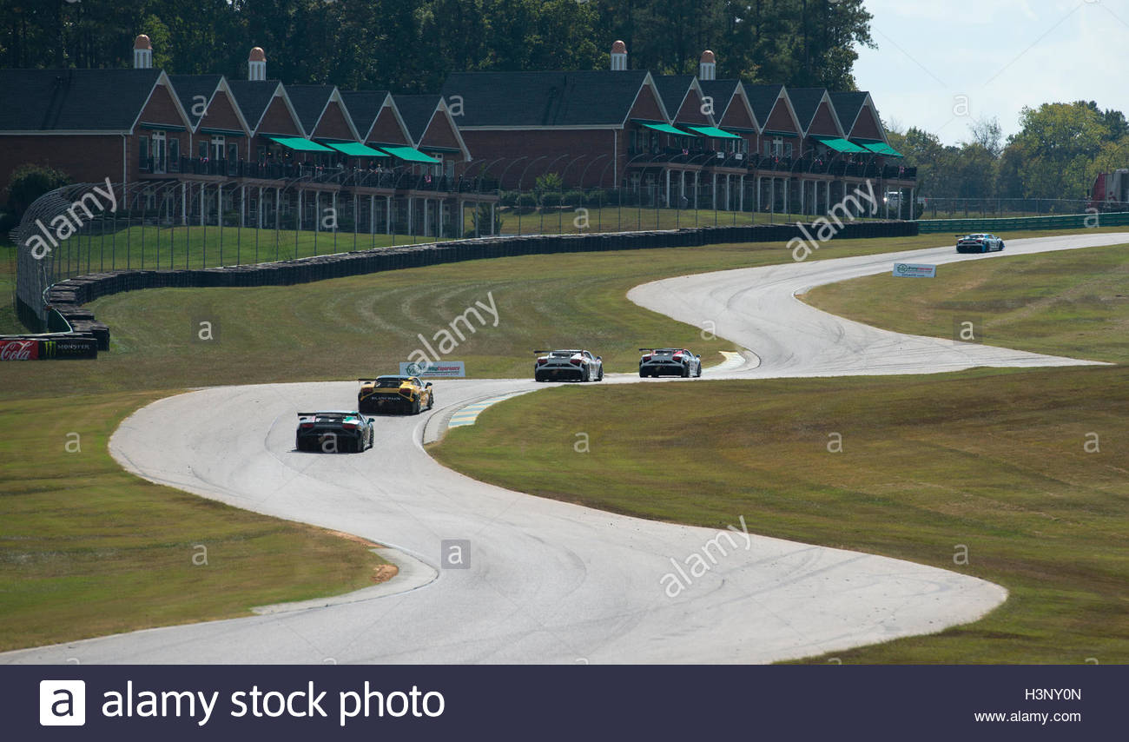
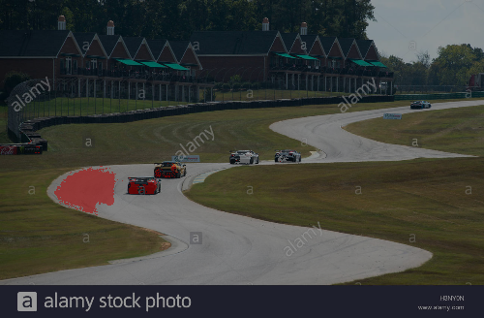
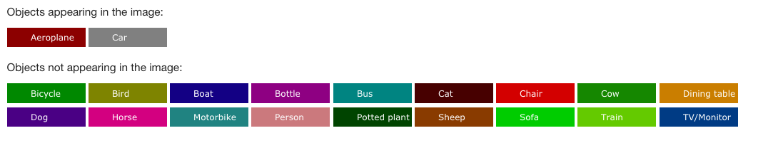
CRF as RNN tested on Random Images
Input
CRF-RNN

Slide 20
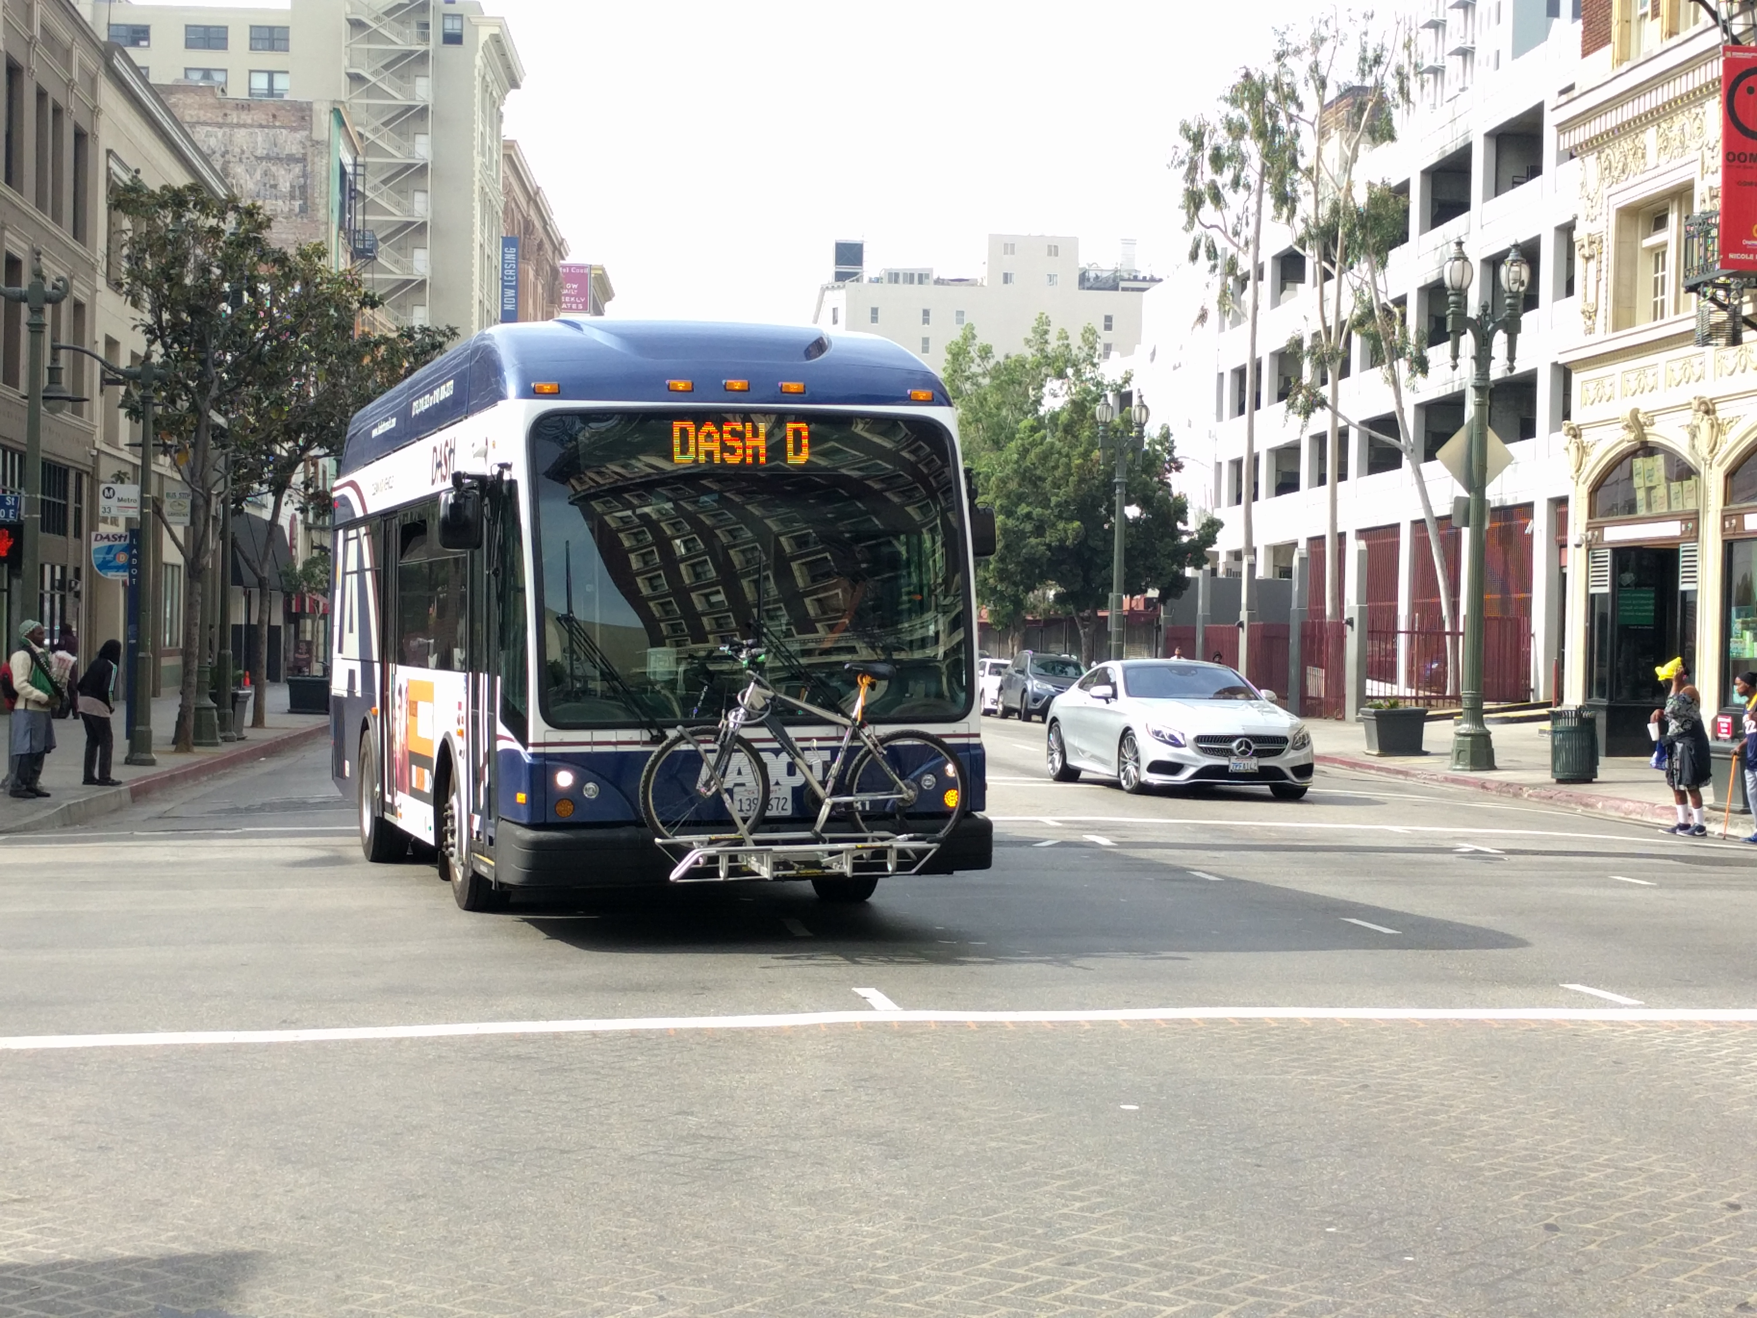
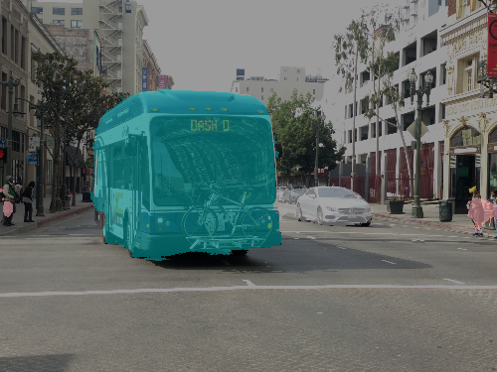
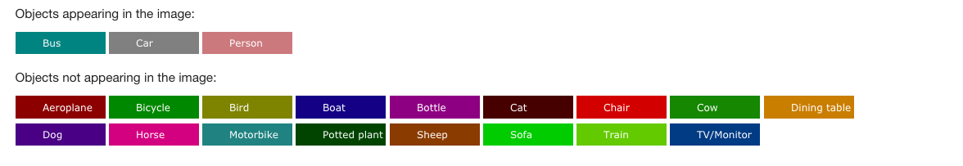
CRF as RNN tested on Random Images
Input
CRF-RNN

Slide 21
Comparison
Both compared on Dataset: MIT_SceneParsing Data
CRF as RNN tested on random Google images
Codes taken from:
https://github.com/shekkizh/FCN.tensorflow#observations
https://github.com/torrvision/crfasrnn

Slide 22
Conclusion
Considering the criticality of applications like autonomous driving or helping visually impaired, there need to be accurately segmented results.

